Slide 1
Inscribed Square Problem
ATEE Problem

Slide 2
Inscribed Square Problem
Does every plane simple closed curve contain all four vertices of some square?
Finding square in a closed loop
Notes:
随便画
圆形
椭圆

Slide 3
Inscribed Rectangle Problem
Finding Rectangle in a closed loop
If we consider pair of point…
Notes:
联系点对

Slide 4
Rectangle
Notes:
对角线等长
交点为中点
等价为找两个点对

Slide 5
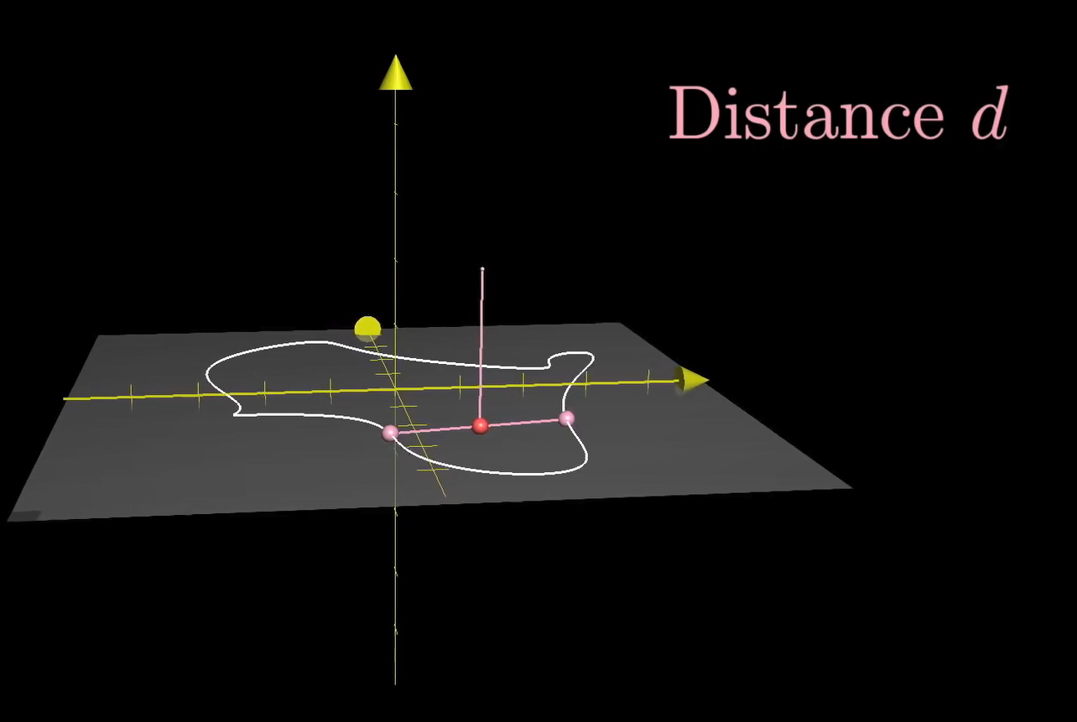
3D-Space
(x,y) => (x,y,z)
(x1,y1),(x2,y2)

Slide 6
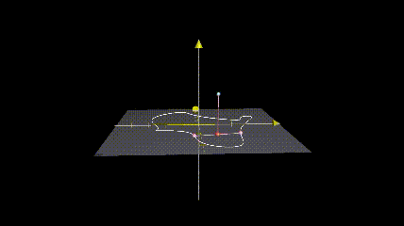
Moving on 3D-Space
Notes:
Why到零点 x,x
Why连续

Slide 7
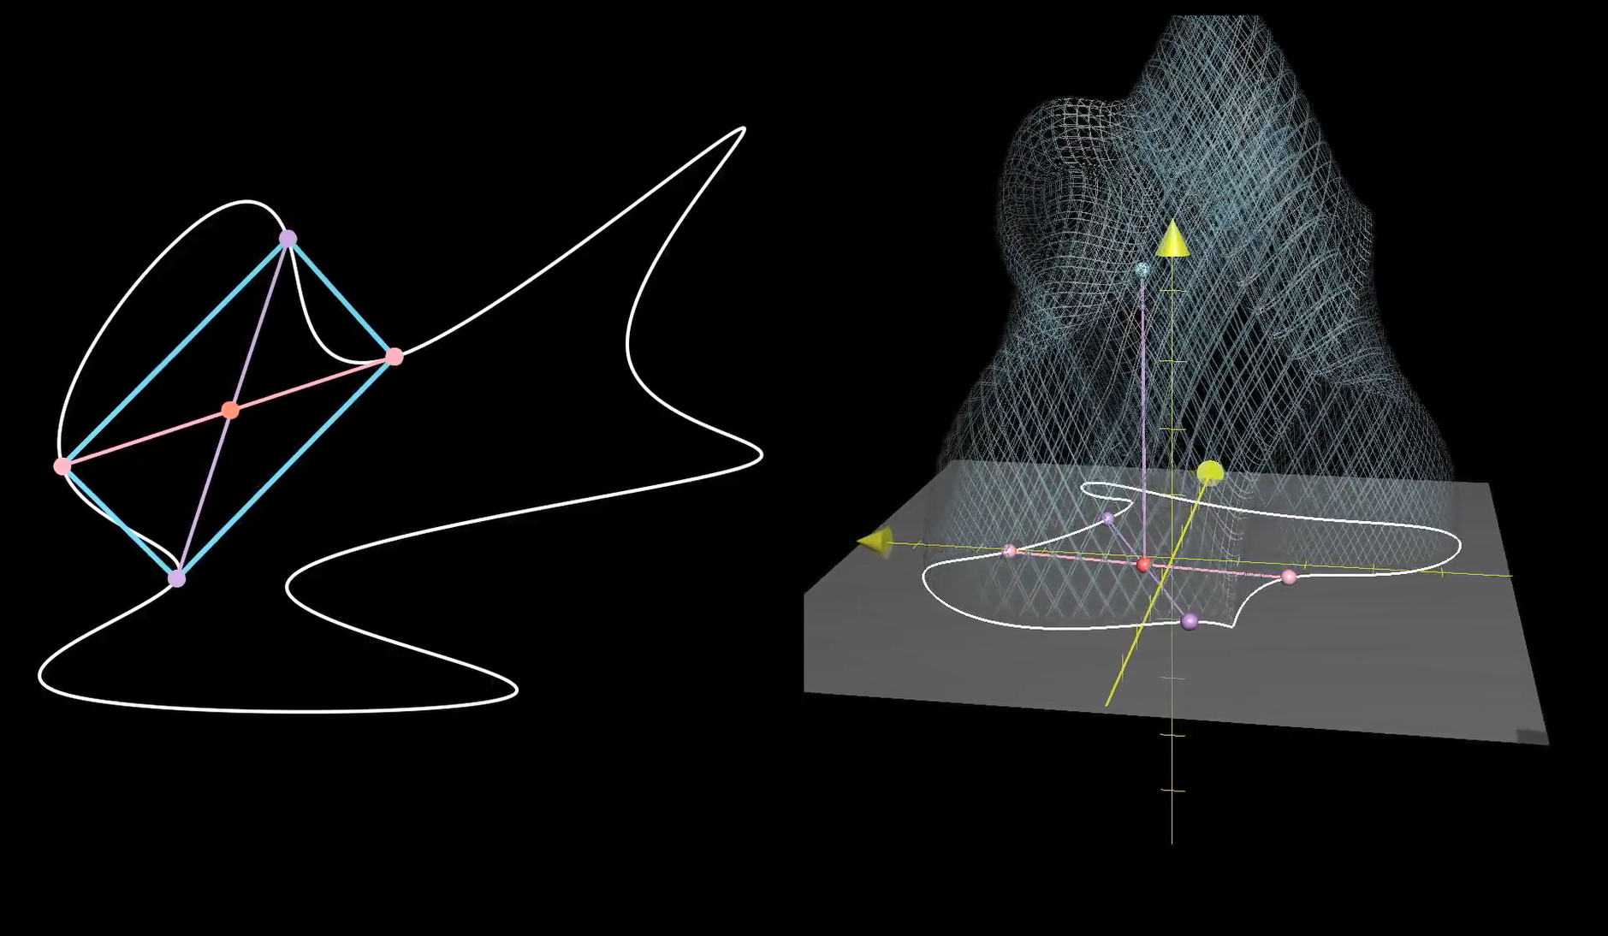

Slide 8
How to represent pairs
Notes:
有序无序
有序
Xy 矩阵 边一样

Slide 9
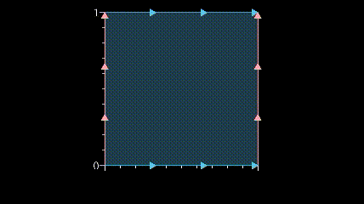
Removing edges…

Slide 10
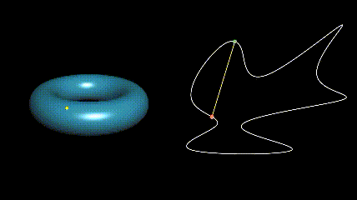
Ordered Pair => Point

Slide 11
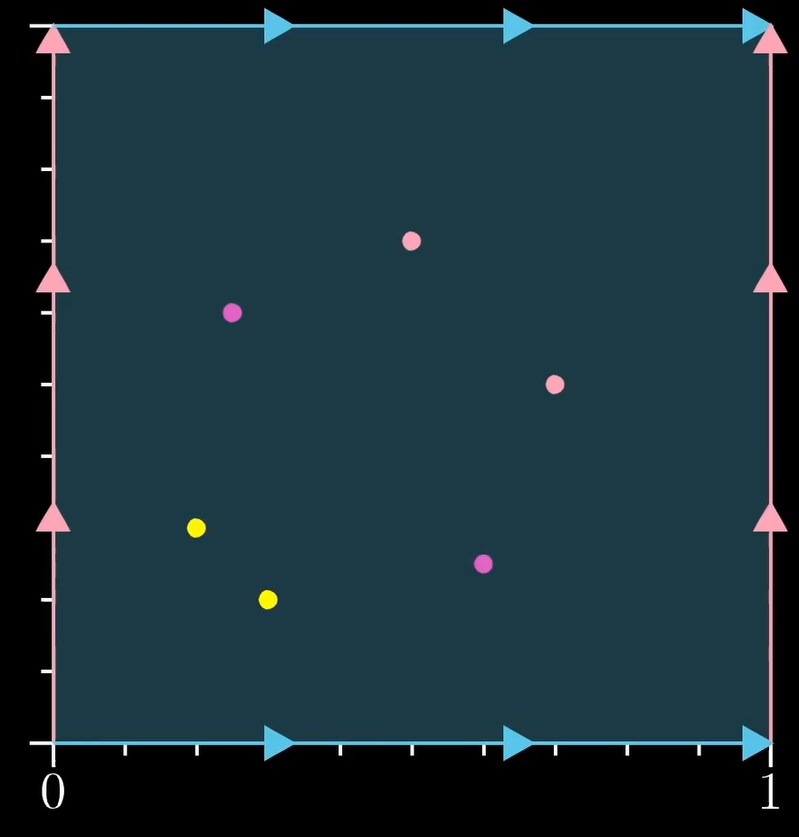
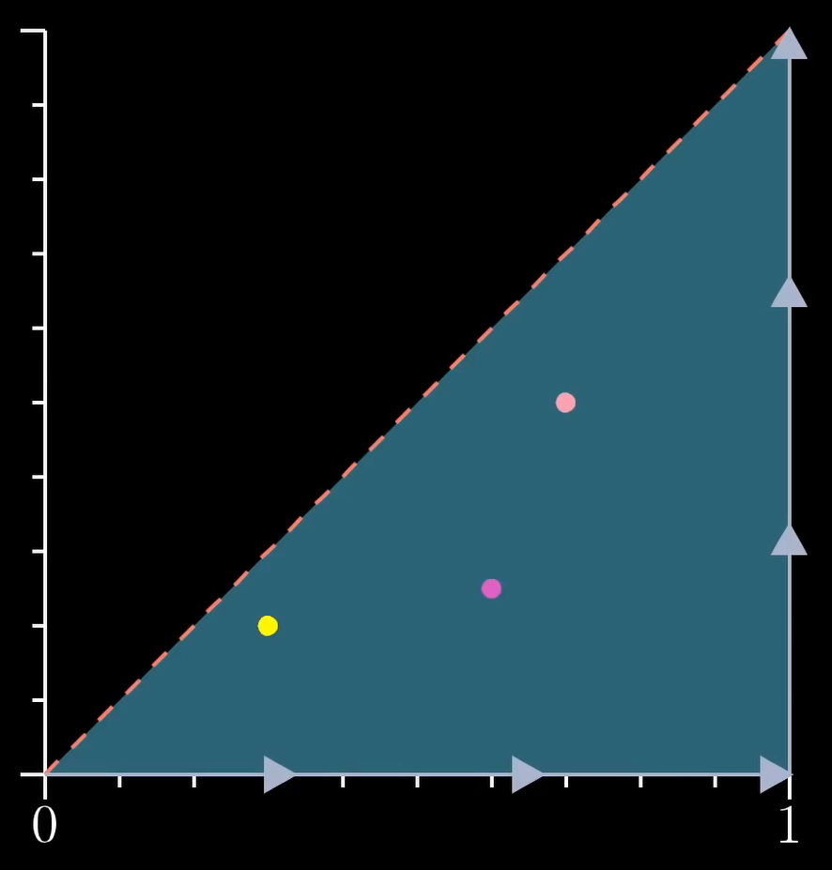
Unordered Pair
Notes:
相同的点
坐标系 对角线折叠

Slide 12
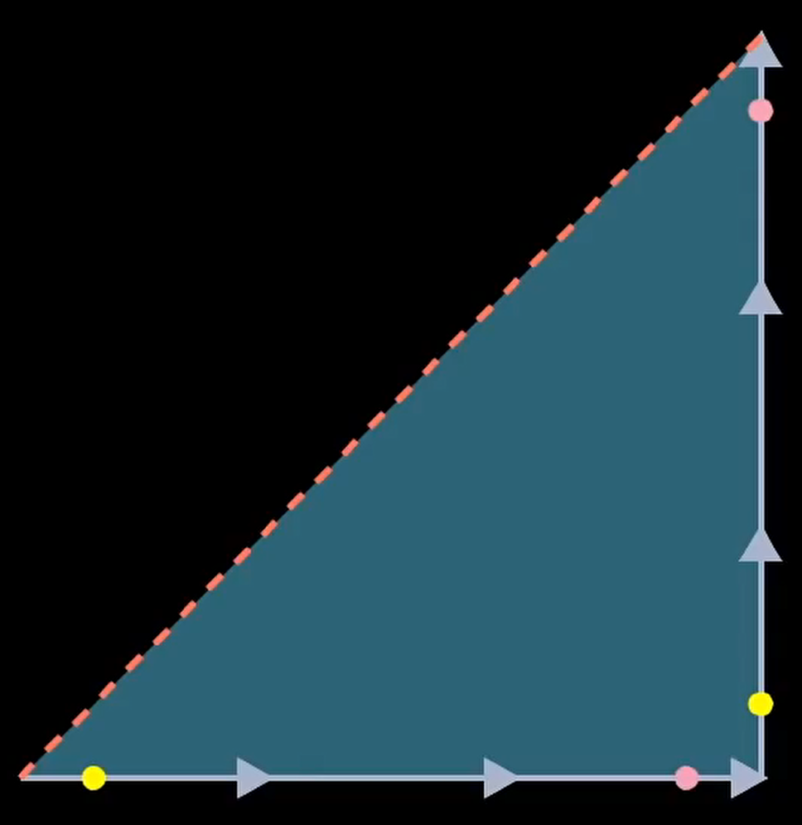
Unordered Pair

Slide 13
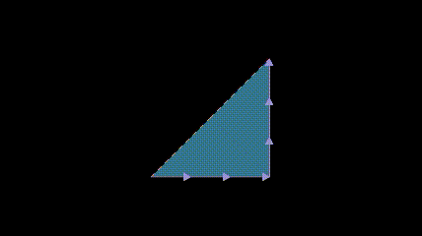
Unordered Pair

Slide 14
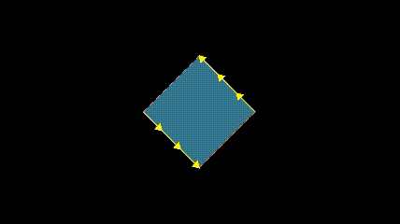
Unordered Pair

Slide 15
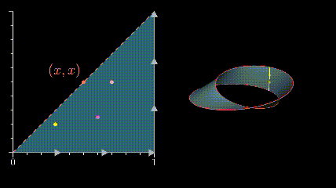
Unordered Pair

Slide 16
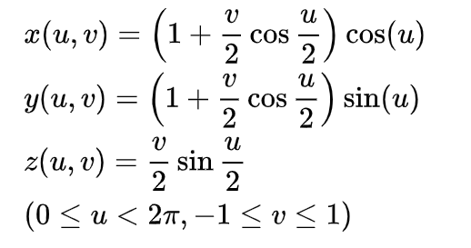
Möbius strip

Slide 17
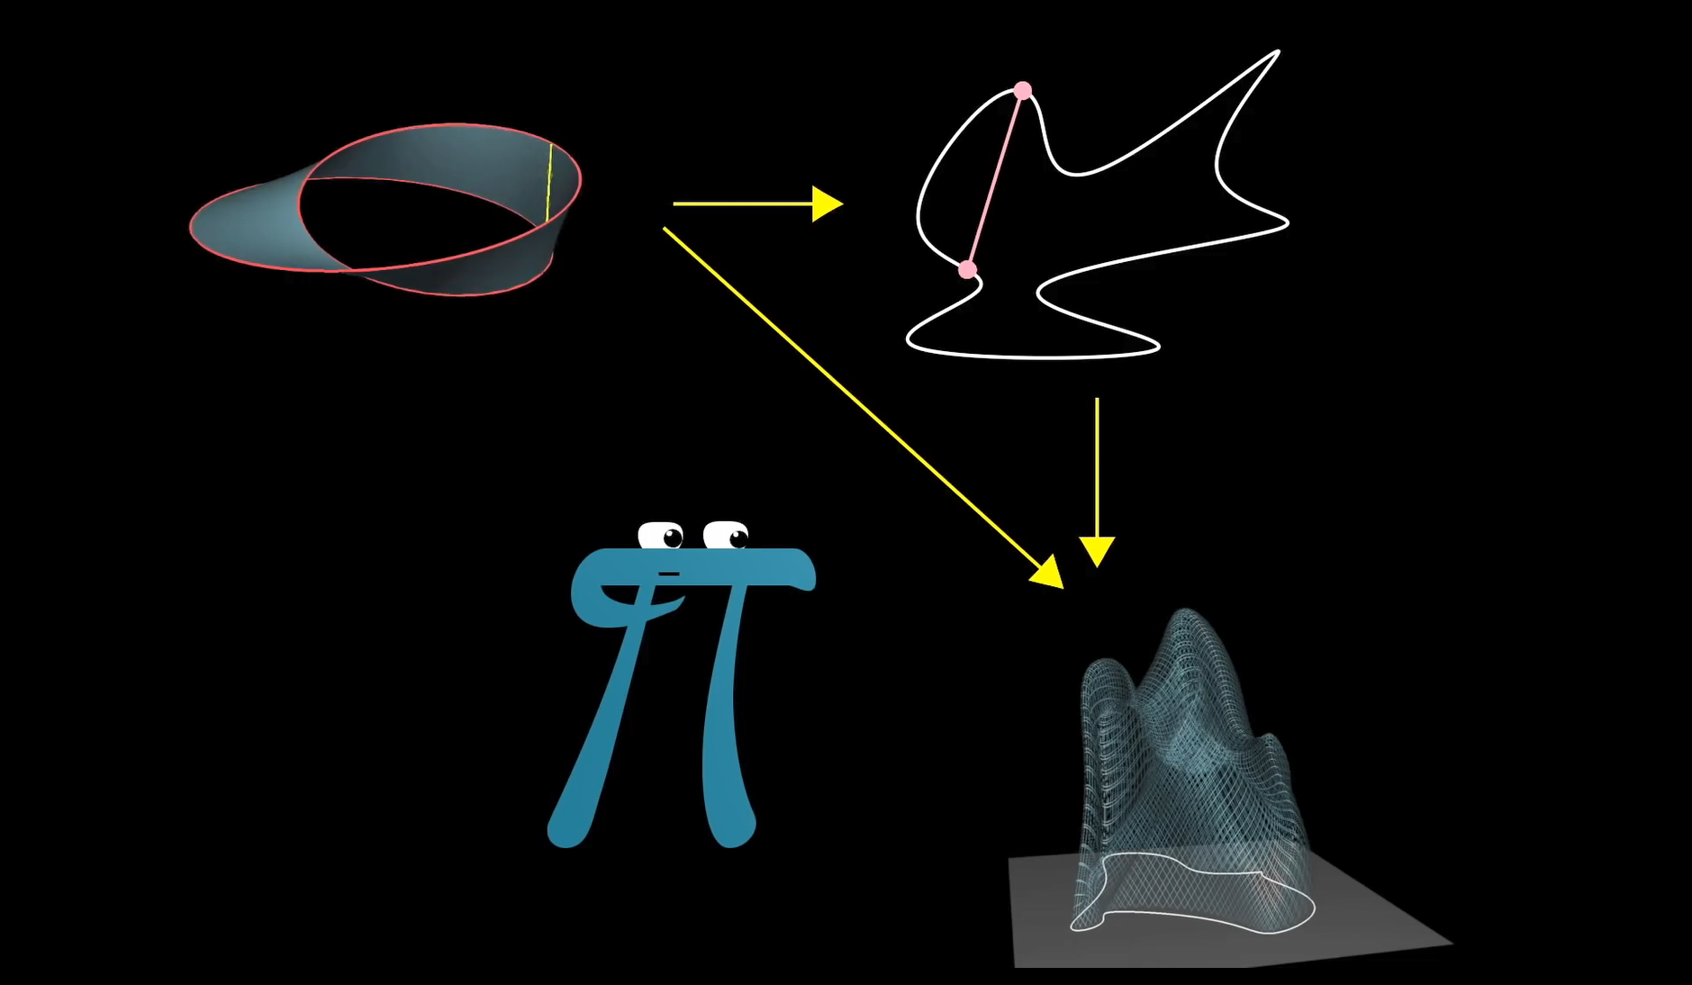

Slide 18
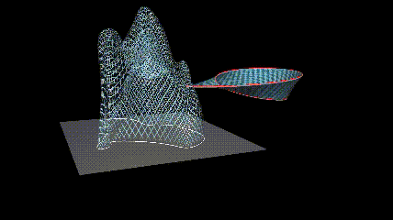
Connection

Slide 19
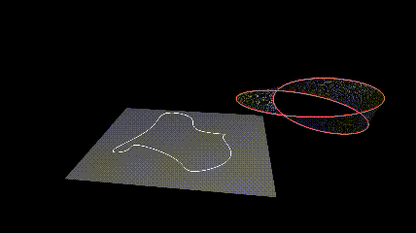
Connection

Slide 20
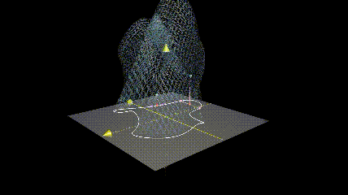
Connection

